Slide 1
Emotion and Wellbeing

Slide 2
How are you?
What do you want in life?

Slide 3
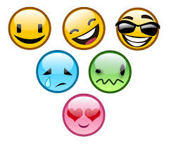
Emotion & Well-Being

Slide 4
Video:
Break into groups:
What were the feelings they were experiencing?
How would you have felt if you were in that position?
Why people felt differently?

Slide 5
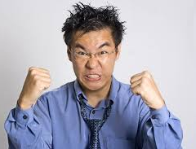
Define Emotion
Feelings that generally have both
physiological and cognitive elements and that
influence behavior.

Slide 6
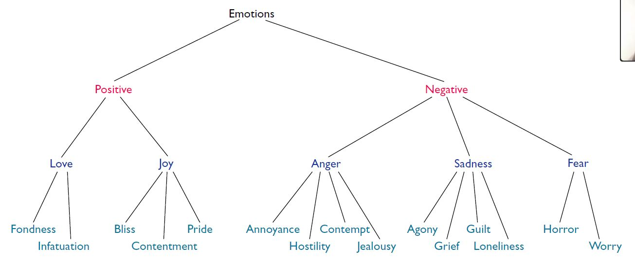
Determining the range of Emotions
Source – Adapted from Fischer et al. 1990

Slide 7
Functions of Emotions
Preparing us for action
Shaping our future behavior
Helping us interact more effectively with others

Slide 8
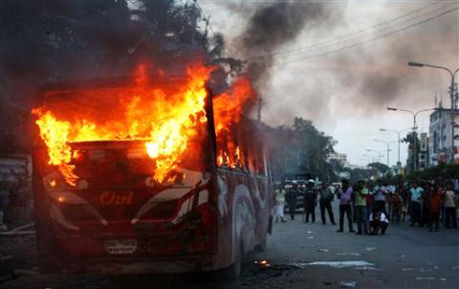
Functions of Emotions
Preparing us for action
In this situation what will you do?

Slide 9
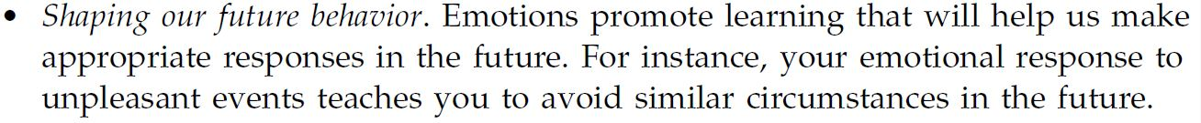
Functions of Emotions

Slide 10
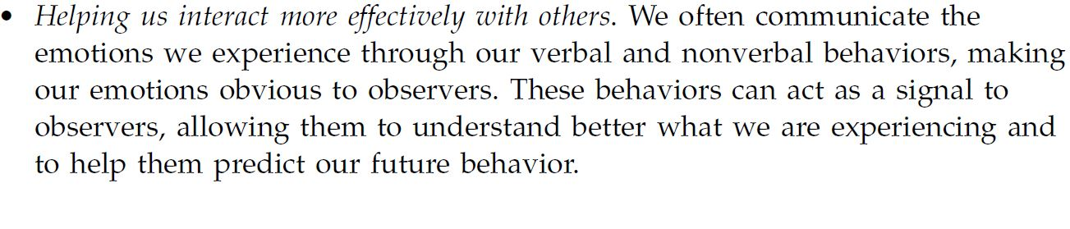
Functions of Emotions

Slide 11
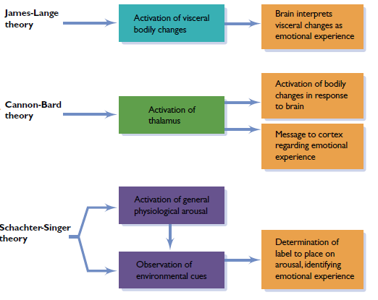
A comparison of three models of Emotions

Slide 12
Video: Mapping Emotion in the body.

Slide 13
Expressed Emotion
How do we communicate non verbally?

Slide 14
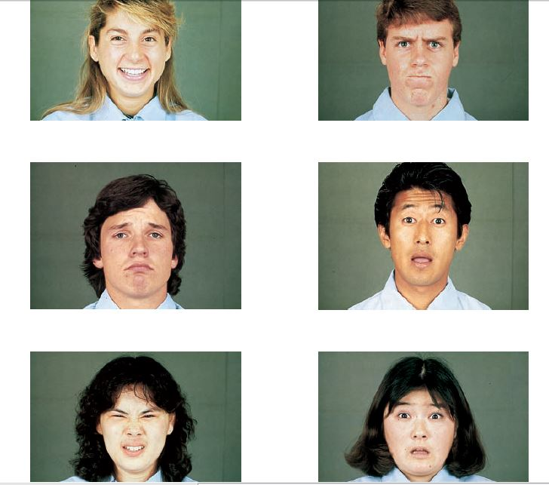

Slide 15
Culture and Emotion Expression
Do people in all cultures express emotion similarly?????

Slide 16
Culture and Emotion Expression
in Chinese literature people clapped their hands to
express worry or disappointment, laughed a great “Ho - Ho” to express anger, and stuck out their tongues to show surprise. Similarly, the North American “thumbs up” and “A-OK” signs are considered insults in certain other cultures.

Slide 17
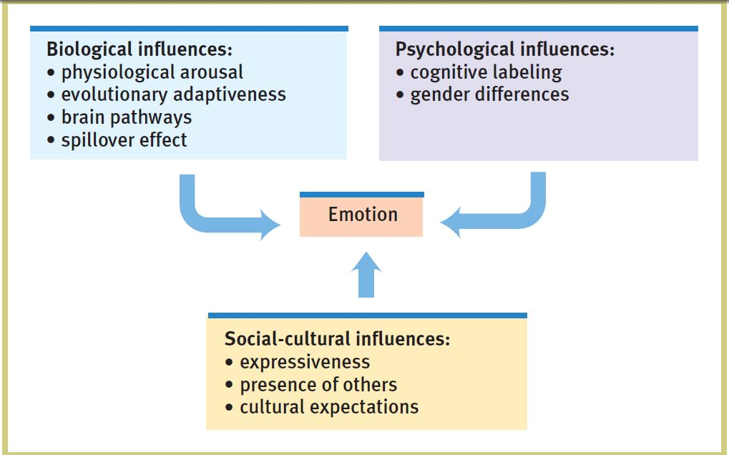

Slide 18
Gender and Emotion Expression
Do boys and girls express emotion in the same way?

Slide 19
Video: Expression of Natural Emotion

